Slide 1
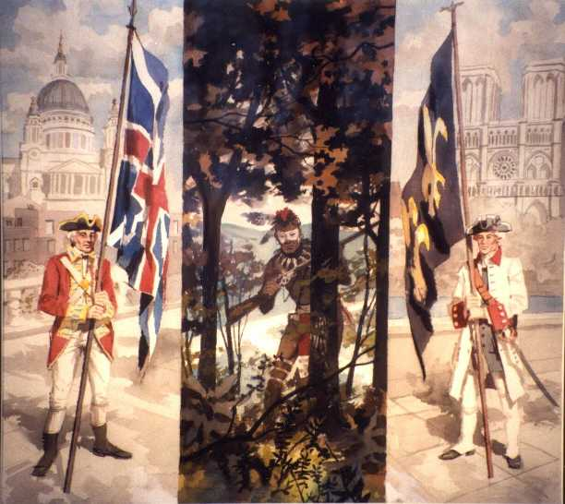
The French and Indian War
Created By: Michael Kelman

Slide 2
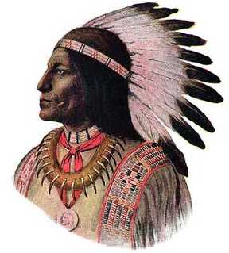
Chief Pontiac (Chief of the Ottawa)
“These lakes these woods and mountains were left to us by our ancestors. They are our inheritance and we will part with them to no one … You ought to know that He, the Great Spirit and Master of Life, has provided food for us in these spacious lakes and on the woody mountains”

Slide 3
The French and Indian War
The war that raged in North America from 1754 to 1763 was apart of a larger struggle between France and England, known as the Seven Years’ War
Most Native American Indians fought on the side of the French
Although few did fight on the side of the English
The war began when the English became alarmed at the Forts being built by the French in the Ohio River Valley and George Washington’s defeat at Fort Necessity
So the English sent General Edward Braddock commander in chief of the British forces to America to drive the French out of the Ohio Valley

Slide 4
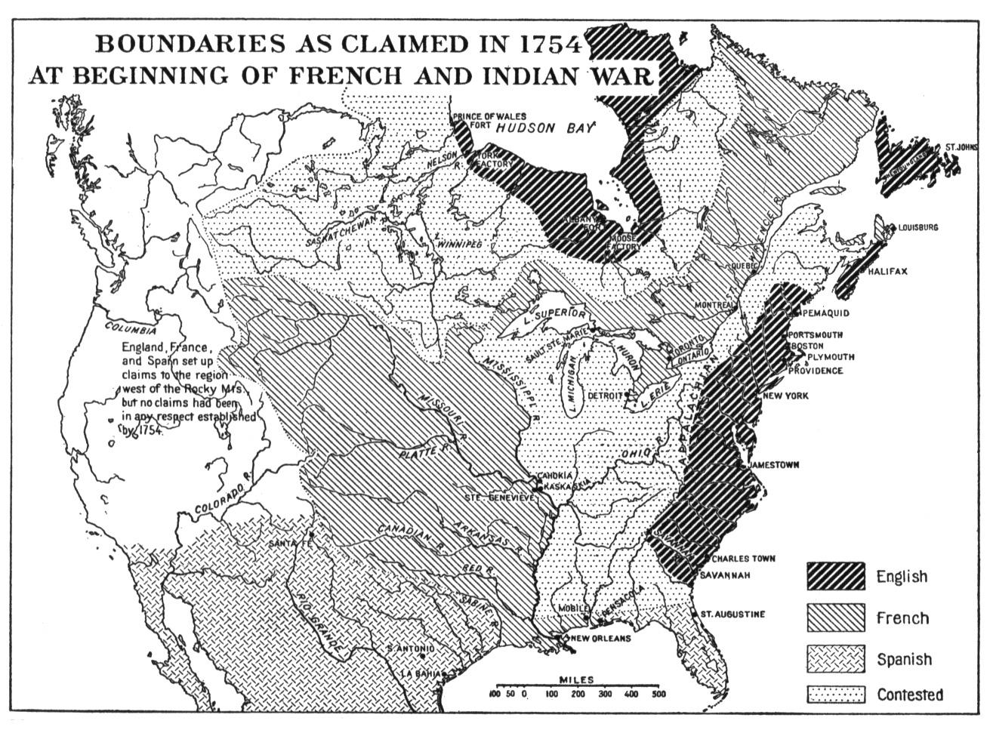

Slide 5
The French and Indian War Braddock Marches to Duquesne
June 1755: Braddock sets out from Virginia with about 1,400 red-coated British troops and a smaller number of blue-coated colonial militias including George Washington as one of his aids
Braddock’s army took several weeks to trek through dense forest to Fort Duquesne
They marched in columns and rows, and took time out everyday to sit and have tea

Slide 6
The French and Indian War Braddock Marches to Duquesne
July 9, 1755: Native American Warriors and French troops ambushed Braddock and his men
The French and Native Americans hid behind trees and fired at the bright uniforms of the British
The British confused and frightened could not even see their attackers
The British lost badly loosing nearly 1,000 soldiers including their Commander in Chief General Edward Braddock

Slide 7
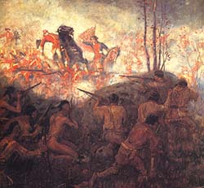
British Lose to French and Indians During March to Duquesne

Slide 8
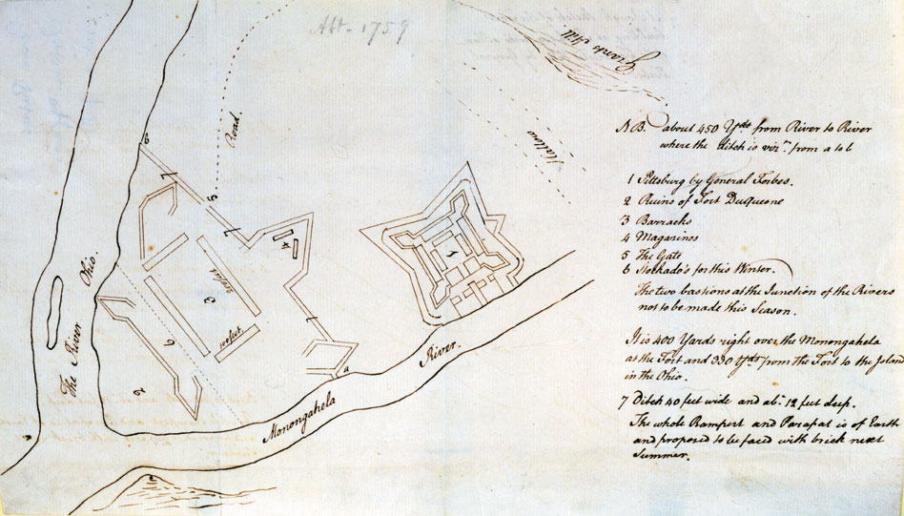
William Trent’s Journal Map of Fort Duquesne/Pitt

Slide 9
The French and Indian War
1756: The fighting in America leads to the start of a war in Europe between the French and English known as the Seven Years War
The first years of the war went terrible for the British and their American colonies
The French captured several British forts including forts at Lake Ontario and Lake George
Frances Native American allies began staging raids on frontier farms from New York to what is now West Virginia
They killed settlers, burned farmhouses and crops, and chased many families back to the coast

Slide 10
French and Indian War Pitt Takes Charge
After William Pitt comes to power as secretary of state and then as prime minister for Great Britain, the tide of the war begins to turn in favor of the British
William Pitt was an outstanding military commander who knew how to pick skilled commanders and oversaw the war effort from London
To avoid complaints from the colonists Pitt decided to pay for the war
However he ran up a huge debt and would raise colonist taxes after the French and Indian War

Slide 11
French and Indian War The British Under Pitt
Pitt intended to conquer French Canada
To do so he sent British troops to North America under the command of officers Jeffrey Amherst and James Wolfe
1758: Amherst and Wolfe recaptured the fortress at Louisbourg
That same year British officers captured Fort Frontenac at Lake Ontario, and recaptured Fort Duquesne (renaming it Fort Pitt)

Slide 12
The French and Indian War The Battle of Quebec
September 1759: British general James Wolfe finds a way to attack the capital of New France Quebec
Perched high on a cliff overlooking the St. Lawrence River the capital was thought of as impossible to attack
A scout for Wolfe found a poorly guarded path up the back of the cliff
Wolfes soldiers overwhelmed the guards on the path and scrambled up it at night
They waited outside the fort on a field called the Plains of Abraham
Here they surprised and defeated the French Army
James Wolfe died in the battle

Slide 13
The French and Indian War The Treaty of Paris
After the fall of Quebec a year later the French took another devastating loss when General Amherst captured Montreal
This brought an end to the fighting in North American
1763: The Treaty of Paris France is permitted to keep some sugar producing islands in the West Indies
1763: The Treaty of Paris England receives Canada and most of Frances islands east of the Mississippi River, England also receives Florida from Frances ally Spain
1763: The Treaty of Paris Spain receives French land West of the Mississippi River (the Louisiana Territory) as well as the port of New Orleans

Slide 14
The French and Indian War The Treaty of Paris
1763: The Treaty of Paris marked the end of France as a power in North America
The continent was now divided between Great Britain and Spain with the Mississippi River marking the boundary
Native Americans still living on the lands and were not given a section of it by the European agreement

Slide 15
Trouble on the Frontier After the French and Indian War
The British victory over the French was a devastating blow to the Native Americans of the Ohio River valley
They had lost their French allies and trading partners
They began to trade with the British but saw them as enemies
The British raised prices of traded goods and unlike the French refused to pay Native Americans for the use of their land
Worst of all, British settlers began moving into the valleys west of Pennsylvania

Slide 16
Pontiac’s War
Chief Pontiac was the leader of an Ottawa village near Detroit
He recognized that the British settlers threatened the Native American way of life
Chief Pontiac formed an alliance of the Shawnee and Delaware tribes to fight the British
Spring 1763: They attacked British forts in the Great Lake region
Summer 1763: The alliance of Native Americans kill settlers in Western PA and Virginia
These raids became known as Pontiac’s War

Slide 17
Pontiac’s War
Although the Native Americans won many battles they failed to capture important forts as: Niagara, Fort Pitt, and Detroit
1765: The Native Americans were defeated by the British
July 1766: Pontiac signed a peace treaty and was pardoned by the British

Slide 18
The Proclamation of 1763
To prevent more fighting King George halted settler’s westward expansion
In the Proclamation of 1763 the Appalachian Mountains were the temporary western boundary for the colonies
This angered many colonists who were already living in the area, or who have recently purchased land in the area
These colonists land claims were now not recognized
The Proclamation of 1763 created friction between the colonies and Great Britain

Slide 19
This powerpoint was kindly donated to www.worldofteaching.com
http://www.worldofteaching.com is home to over a thousand powerpoints submitted by teachers. This is a completely free site and requires no registration. Please visit and I hope it will help in your teaching.

